Slide 1
Analysis of Murder in Chicago
What impacts homicide rates?
Matt Canady & Alivia Varvel

Slide 2
Core message
Dive into potential impacts on homicide rates in Chicago. Does location have an effect? Temperature? Time of year? Socioeconomic factors?

Slide 3
Questions Asked
Initial questions:
How does weather impact crime?
How does Police Station location and officer beat impact crimes
Does time of day impact crime?
Are there relationships between crime and basic census groups?
Addressed questions:
How do homicide rates trend over time?
Does temperature impact homicides?
What are the homicide rates for each ward in Chicago?
What percentage of homicides occur each month?
Are poverty levels and homicide rates correlated? How does it differ for each community area in Chicago?

Slide 4
Finding data
Data we planned to use:
data.cityofchicago.org
Crimes 2001 – Present Dataset
Locations of Police Stations
US Census API
Open Weather API
Data we actually used:
data.cityofchicago.org
Used datasets of crime for 2001, 2006, 2011, 2016, and the past year.
Used dataset of poverty levels for community areas in Chicago from 2008-2012.
Kaggle
Used dataset of historical temperatures for Chicago.
US Census API
Requested poverty levels data from the American Community Survey for 2006, 2011, and 2016

Slide 5
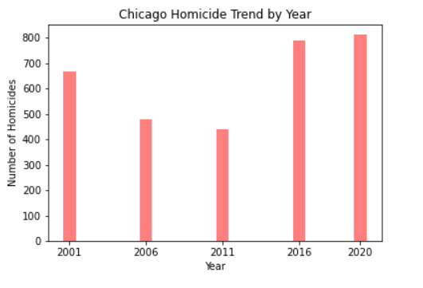
Cleanup & Analysis
Are the number of homicide cases in the city of Chicago trending up or down?
Data for crimes in Chicago was pulled and merged into one data set and then filtered for homicides and graphed to see the general trend
Homicide cases were on the decline from 2001 through 2011 and then increased in 2016 and 2020 with 2020 being the peak in the dataset

Slide 6
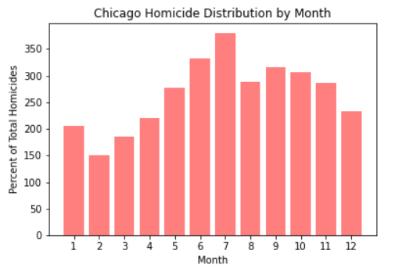
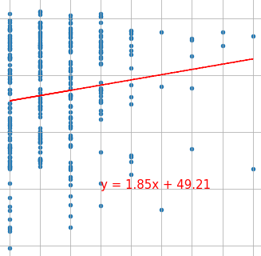
Cleanup & Analysis
Is there a relationship between the weather and number of homicide cases?
First look was taking the total number of cases of homicide by month and graphing to see if it was worth investigating further as there is a clear difference in temperature across seasons in Chicago
Initial graph of cases by month shows what appears to be a peak in summer month
Investigating further we pulled temperature by day into the data set and graphed a scatter plot to look at relationship between average temperature for the day and volume of homicide cases reported
Scatterplot and regression analysis showed that there is no relationship as there is an r value of .02

Slide 7
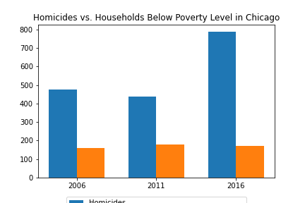
Cleanup & Analysis
Are poverty levels and homicide rates correlated?
Used Census API to get # of households below the poverty level in Chicago (2006, 2011, 2016)
Combined with dataset containing the number of homicides for each year
Created bar chart comparing homicides & poverty levels

Slide 8
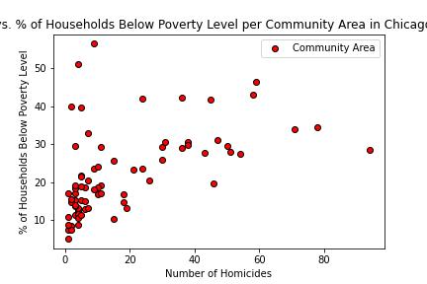
Cleanup & Analysis
How does homicides vs poverty levels differ for each community area?
Used dataset containing poverty levels information for community areas – 2008-2012
Combined with dataset containing the number of homicides for area
Created scatter plot comparing homicides & poverty levels

Slide 9
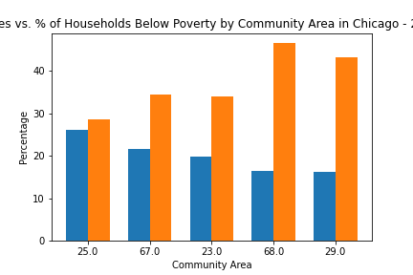
Cleanup & Analysis
How does homicides vs poverty levels differ for each community area?
Scatter plot didn’t have clear trend
Found top 5 areas with most homicides from 2008-2012
Created bar chart comparing percentages of homicides & poverty levels

Slide 10
Discussion of Findings:
Question: How are the number of cases of homicide trending in Chicago?
The data we pulled showed that the number of cases of homicide was on the decline through 2011, but then something changed and increased in 2016 and 2020
Question: Does weather have an impact on the volume of homicide cases?
The initial data of the volume of cases by month indicated that there is a potential for a relationship as the data showed a peak in the summer months and declines in the winter months
This lead to further investigation in looking at the relationship between the average temperature for the day and the number of cases reported that day
The surprising conclusion from this analysis showed that there was no relationship between temperature and volume of cases
This does not mean that seasonality does not exist, it only shows that temperature is not a factor in the sample year of 2016 that the analysis was conducted on

Slide 11
Discussion of Findings:
Question: Are poverty levels and homicide rates correlated?
There isn’t a strong correlation between poverty levels and homicides in Chicago.
Top 5 areas with the most homicides show a potential negative correlation between the two. When homicide rates are higher, poverty rates are lower.
Expected to see poverty rates being higher where homicide rates are higher.

Slide 12
Post Mortem:
The data that was loaded into the web site for the city was not consistent and required a fair amount of cleaning as there were different naming conventions and formats used as well as data included in some years and not in other
Difficult to find the data we wanted
Census API was a bit difficult to use
We didn’t have the time/resources to address all the questions we wanted

Slide 13

QUESTIONS

